Slide 2




Artifact Registries
Extending Artifacts to support Supply Chain Reference Types
Steve Lasker
Program Manager / Architect
Azure Container Registries
Steve.Lasker@Microsoft.com
@SteveLasker
SteveLasker.blog
github.com/SteveLasker
github.com/SteveLasker/presentations
Justin Cormack
CTO
Docker
justin@docker.com
@justincormack
cloudatomiclab.com
github.com/justincormack
.blog
.blog

Slide 3
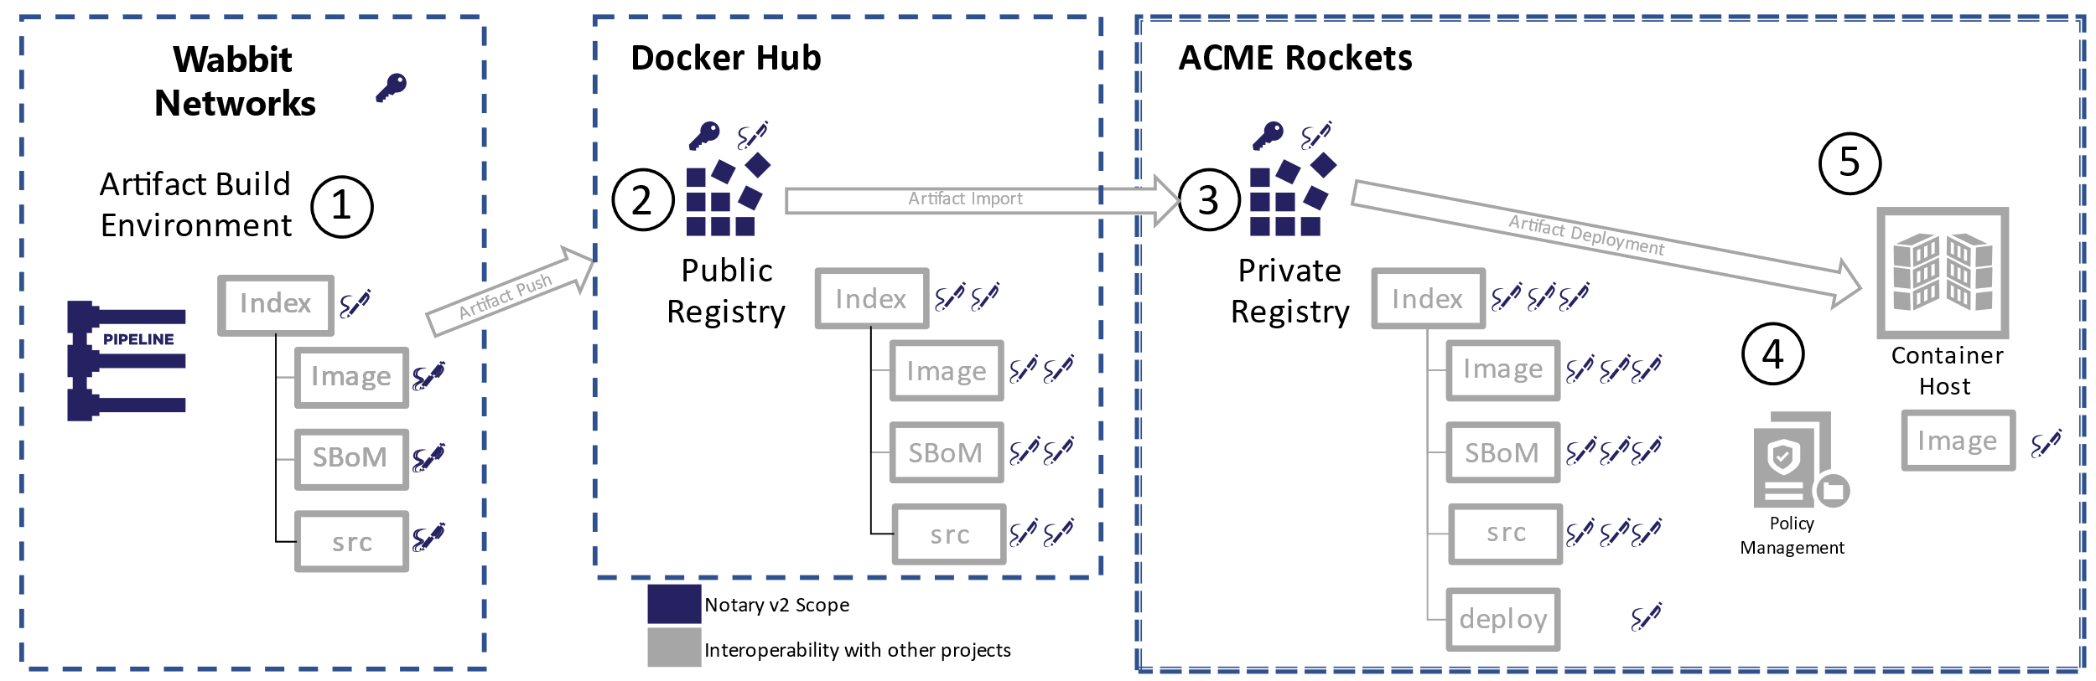
Enabling the Supply Chain

Slide 4
What are the Supply Chain Artifact Types
Software Bill of Materials (SBoMs)
SPDX, CycloneDX, …
Security Scan Results, (list of vulnerabilities, at a point in time)
Formats starting to evolve (ossf/wg-vulnerability-disclosures)
More will exist
GPL Source, optionally including the source used to build the artifact
Signatures: proof of identity, by trusted providers, delivered end to end
Anything that can be represented as collections of one or more files
Can be multiple collections of files as well

Slide 5
Supply Chain Artifact Challenges
Artifacts are copied across environments
Pubic → Shared Internal → Dev → Staging → Prod
Many of these destinations are within restricted networks (Vnets)
The supply chain objects should travel with the artifacts
Enabling evaluation and validation of the supply chain objects, where the content is consumed from

Slide 6

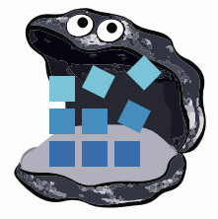












Container Registries
→ Artifact Registries
!
Y
Yet
Another
Storage
Solution
A
S
S

Slide 7
Registries & Reference Types
Registries are ubiquitous across all cloud providers
Cloud, On-Prem, IoT
Support performance, reliability, security capabilities from dev-prod
Users want fewer services to run, configure & maintain
Artifact authors want to focus on their thing
Does the SPDX Community want to design, spec, build, service an SPDX Service?

Slide 8
Artifact: Reference Type Principals
Multiple artifacts exist, and none should have to create YASS¹
Persisted alongside the subject artifact
Solves the discovery problem & network isolated/air-gapped environments
Reference Types artifacts can be copied with the target artifact
Associated with, but separable from the target artifact
Solves the trojan horse validation challenge
Target artifact must not change when adding new artifacts
docker pull mcr.microsoft.com/dotnet/runtime:5.0
docker pull mcr.microsoft.com/dotnet/runtime@sha256:ca9c27f79cfc669d74befcd93f
Helm chart references
Kubedeploy.yaml references
1- YASS- Yet Another Storage Service

Slide 9




Artifact: Reference Types
ACME Rockets Registry
Reference Types enable adding objects, which refer to a target artifact
net-monitor:v1
mediaType: oci.image.manifest
config (blob)
layer1 (blob)
layer2 (blob)
docker push net-monitor:v1
wabbit-networks signature
mediaType: cncf.oras.artifact.manifest.v1
artifactType : org.cncf.notary.v2
signature [blobs]
reference (subjectManifest)
notation sign net-monitor:v1 (notation cli incorporates push as a reference type)
SBoM Document
mediaType: cncf.oras.artifact.manifest.v1
artifactType: org.spdx.sbom.v3
sbom [blobs]
reference (subjectManifest)
spdx report net-monitor:v1
spdx push net-monitor:v1
(sbom cli incorporates nv2 sign)
wabbit-networks signature
mediaType: cncf.oras.artifact.manifest.v1
artifactType: org.cncf.notary.v2
signature [blobs]
reference (subjectManifest)

Slide 10
net-monitor:v1
mediaType: oci.image.manifest
Demo Time
config (blob)
layer1 (blob)
layer2 (blob)
wabbit-networks signature
mediaType: cncf.oras.artifact.manifest.v1
artifactType: org.cncf.notary.v2
signature [blobs]
reference (subjectManifest)
SBoM Document
mediaType: cncf.oras.artifact.manifest.v1
artifactType: org.spdx.sbom.v3
Push, Discover, Pull Supply Chain Reference Types
sbom [blobs]
reference (subjectManifest)
wabbit-networks signature
mediaType: cncf.oras.artifact.manifest.v1
artifactType: org.cncf.notary.v2
signature [blobs]
reference (subjectManifest)

Slide 11

Artifact Copying
The reference graph enables deep, shallow of filtered copying
ACME Rockets
The reference graph enables deep, shallow of filtered copying
net-monitor:v1
net-monitor:v1
mediaType: oci.image.manifest
mediaType: oci.image.manifest
Artifact Copy
config (blob)
config (blob)
layer1 (blob)
layer1 (blob)
layer2 (blob)
layer2 (blob)

Slide 12

Artifact Copying
oci-reg copy \
--source docker.io/wabbitnetworks/net-monitor:v1 \
--target registry.acme-rockets.io/base-artifacts/net-monitor:v1
oci-reg copy \
--source docker.io/wabbitnetworks/net-monitor:v1 \
--target registry.acme-rockets.io/base-artifacts/net-monitor:v1 \
--include-references org.spdx.sbom.v3
oci-reg copy \
--source docker.io/wabbitnetworks/net-monitor \
--target registry.acme-rockets.io/base-artifacts/net-monitor:v1 \
--exclude-references org.scannerco.result.v1
ACME Rockets
net-monitor:v1
net-monitor:v1
mediaType: oci.image.manifest
mediaType: oci.image.manifest
config (blob)
config (blob)
layer1 (blob)
layer1 (blob)
layer2 (blob)
layer2 (blob)
wabbit-networks signature
wabbit-networks signature
mediaType: cncf.oras.artifact.manifest.v1
artifactType: cncf.notary.v2
mediaType: cncf.oras.artifact.manifest.v1
artifactType: cncf.notary.v2
signature [blobs]
signature [blobs]
reference (subjectManifest)
reference (subjectManifest)
Artifact Copy
SBoM Document
SBoM Document
mediaType: cncf.oras.artifact.manifest.v1
artifactType: org.spdx.sbom.v3
mediaType: cncf.oras.artifact.manifest.v1
artifactType: org.spdx.sbom.v3
sbom [blobs]
sbom [blobs]
reference (subjectManifest)
reference (subjectManifest)
wabbit-networks signature
wabbit-networks signature
mediaType: cncf.oras.artifact.manifest.v1
artifactType: cncf.notary.v2
mediaType: cncf.oras.artifact.manifest.v1
artifactType: cncf.notary.v2
signature [blobs]
signature [blobs]
reference (subjectManifest)
reference (subjectManifest)

Slide 13

Artifact Reference Types
OCI Artifacts: github.com/opencontainers/artifacts
ORAS Artifact Reference Types: github.com/oras-project/artifacts-spec
CNCF Distribution Reference Types: github.com/oras-project/distribution
Notary v2: github.com/notaryproject/notaryproject
Steve Lasker
Program Manager
Azure Container Registries
Steve.Lasker@Microsoft.com
@SteveLasker
SteveLasker.blog
github.com/SteveLasker
github.com/SteveLasker/presentations
Justin Cormack
CTO
Docker
justin@docker.com
@JustinCormack
cloudatomiclab.com
github.com/justincormack
Thank You

